Slide 1
Classification and pathogenesis of diabetes in pediatrics
Sayarifard.F
Associate professor in pediatric endocrinology & metabolism
Children’s excellence medical center,
Growth and development research center
Tehran university of medical sciences

Slide 2
Contents
Criteria for diagnosis of DM
Classification
Pathogenesis
Case presentation

Slide 3
Criteria for the diagnosis of diabetes mellitus

Slide 4
PPG= 140-199 mg/dl
(IGT)
FPG=100-125 mg/dl
(IFG)
Pre diabetes
PPG≥200 mg/dl
FPG≥126 mg/dl
Diabetes
PPG= ≤ 139 mg/dl
FPG=70-99 mg/dl
Non diabetic
American Diabetes Association. Standards of Medical care in Diabetes-2019.

Slide 5
The etiological classification recommended by the American Diabetes Association, ISPAD and the WHO expert committee on the classification and diagnosis of diabetes.
The differentiation between type 1, type 2 and monogenic diabetes has important implications for both therapeutic decisions and educational approaches.

Slide 6
Etiologic classification
Type 1 diabetes (due to autoimmune b-cell destruction)
Type 2 diabetes (due to a progressive loss of b-cell insulin secretion frequently on the background of insulin resistance)
Specific types of diabetes due to other causes, e.g., monogenic diabetes syndromes(such as neonatal diabetes and MODY),diseases of the exocrine pancreas (such as cystic fibrosis and pancreatitis), and drug- or chemical-induced diabetes (such as with glucocorticoid)
Gestational diabetes mellitus (GDM)

Slide 7
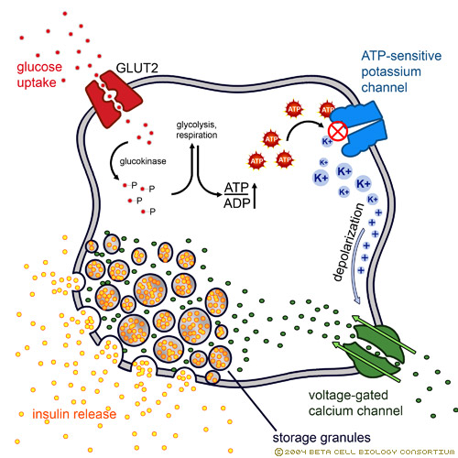
Insulin secretion

Slide 9
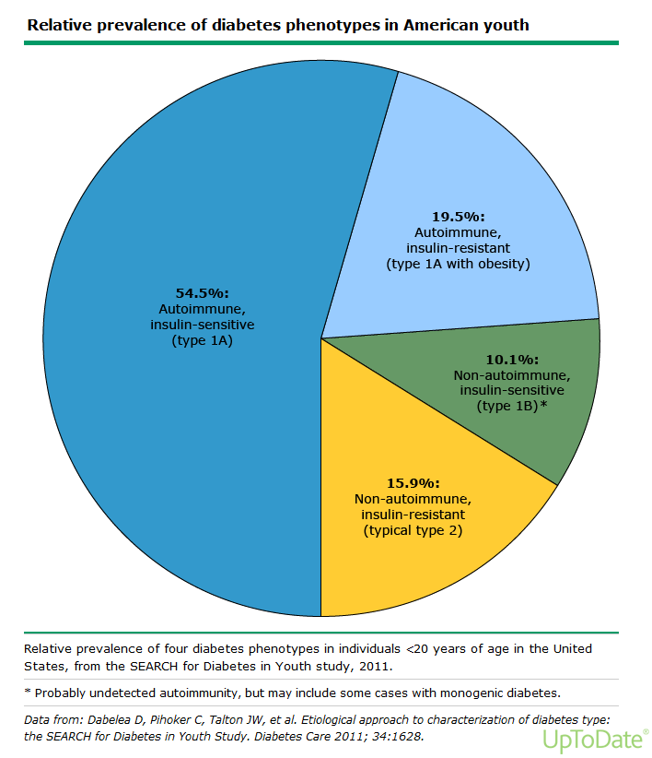

Slide 10
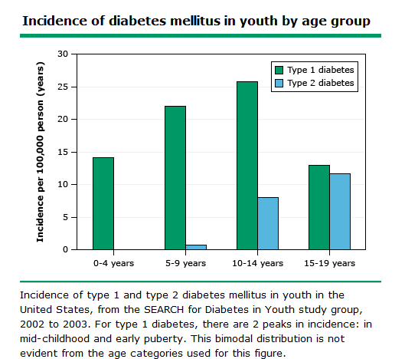

Slide 11
Pathogenesis of type 1 DM
Type 1A diabetes mellitus results from autoimmune destruction of the insulin-producing beta cells in the islets of Langerhans
This process occurs in genetically susceptible subjects, is probably triggered by one or more environmental agents
Polymorphisms of multiple genes are known to influence the risk of type 1A diabetes.
There are a number of autoantigens within the pancreatic beta cells that may play important roles in the initiation or progression of autoimmune islet injury including glutamic acid decarboxylase (GAD), insulin, insulinoma-associated protein 2 (IA-2), and zinc transporter ZnT8.
Environmental factors that may affect risk include pregnancy-related and perinatal influences, viruses, and ingestion of cow's milk (bovine serum albumin) casein hydrolysate formula is better than conventional formula ,and cereals, nitrates
Protective factors: vitamin D and omega3
Notes:
They were maternal age >25 years, preeclampsia, neonatal respiratory disease, and jaundice, especially that due to ABO blood group incompatibility; protective factors were low birth weight and short birth length.
infection from Coxsackie, Epstein-Barr virus, mumps, or cytomegalovirus
human leukocyte antigen [HLA]-DQalpha; HLA-DQbeta; HLA-DR, preproinsulin, the PTPN22 gene, and CTLA-4), with whole-genome analysis providing additional genes and loci, such as KIAA0035 (a lectin). Genes in both the major histocompatibility complex (MHC) and elsewhere in the genome influence risk, but only HLA alleles have a large effect.

Slide 12
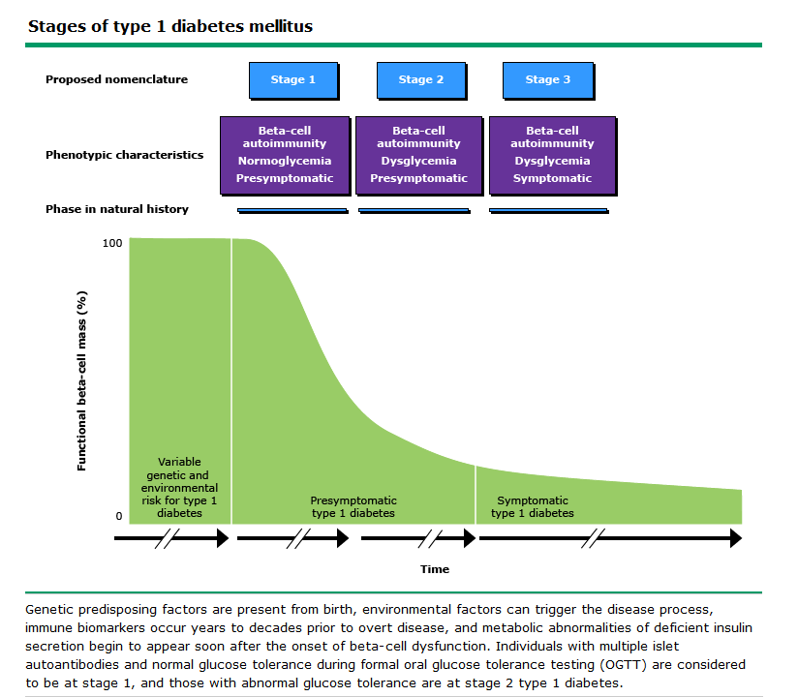

Slide 13
Staging of type 1 diabetes

Slide 14
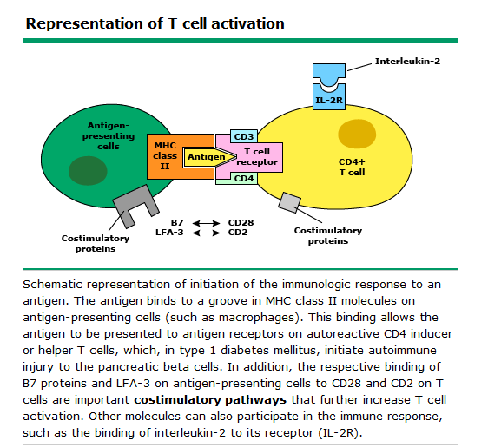

Slide 15
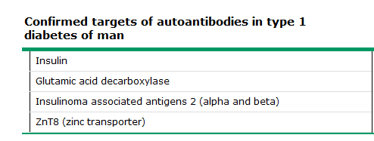
The presence of one of more of these antibodies confirms the diagnosis of type 1 diabetes .
The diagnosis of type 1 diabetes, since one and usually more of these autoantibodies are present in >90% of individuals when fasting hyperglycemia is initially detected.

Slide 16
Who are suspected other types of diabetes?
The child who has negative diabetes-associated autoantibodies and :
An autosomal dominant family history of diabetes (maturity onset diabetes of the young (MODY)
Age less than 12 months and especially in first 6 months of life (NDM [neonatal diabetes mellitus])
Mild-fasting hyperglycemia (100-150 mg/dL),especially if young, non-obese, and asymptomatic
A prolonged honeymoon period over 1 year (low requirement for insulin of ≤0.5 U/kg/day )
Marked insulin resistance ,High level of fasting insulin or C-peptide
Associated conditions such as deafness, optic atrophy, or syndromic features
History of exposure to drugs known to be toxic to β-cells or cause insulin resistance

Slide 17
ADA 2021 recommendations
Plasma blood glucose rather than A1C should be used to diagnose the acute onset of type 1 diabetes in individuals with symptoms of hyperglycemia.
Screening for type 1 diabetes risk with a panel of autoantibodies is currently recommended only in the setting of a research trial or in first-degree family members of a proband with type 1 diabetes.
Persistence of two or more autoantibodies predicts clinical diabetes and may serve as an indication for intervention in the setting of a clinical trial.

Slide 20
CASE
A 9-year-old boy from northern Iran was referred to the Children’s Medical Center, the Pediatrics Center of Excellence in Tehran-Iran, for evaluationof high fasting plasma glucose. He was from unrelated parents, and his mild hyperglycemia has been accidentally discovered a few months before during routine laboratory tests.
He did not have polydipsia and polyuria, neither any weight loss.
On examination, he was healthy and non-obese.He had no acanthosis nigricans. Fasting blood sugar(FBS) 114 mg/dL,HbA1c 6.5%.A standard oral glucose tolerance test (OGTT) with 75g of glucose equivalent was performed with a fasting glucose of 125 mg/dL and 2-hour glucose of 133 mg/dL.
Fasting insulin concentration was 7.5 μIU/mL. No glucosuria or ketonuria were detected. The pancreatic islet cell autoantibodies(ICA)and glutamic acid decarboxylase autoantibodies (GADA) were negative.
The mother was healthy, the 41-year-old father had an FBS of 115 mg/dL and his blood glucose was 162 mg/dL at 2-hours after GTT.

Slide 21
Both clinical presentation and laboratory data were highly suggestive of a GCK mutation.(MODY2)
Genetic studies showed heterozygous inactivating GCK gene mutation in exon 8 (c.1010delA)in this patient.
The same mutation was found in his father as well.
The patient received some dietary advices without any medication.

Slide 22
case
A 8 years old boy admitted in children’s medical center with polyuria and polydipsia.
He was overweight.
Lab data:
VBG: PH: 7.28 HCO3:15 ; BS:360 : U/A: Ketone 1+ & glucose 2+
He treated by DKA protocol
He discharge by analogue insulins 1 unit/kg

Slide 23
After 2 weeks:
HBA1C:11.5
SMBG : 80 UP TO 250
TFT: NL TTG: NEG VIT D:4 (VERY LOW)
ANTI GAD: NEG
ANTI ISLET AB: NEG
ANTI INSULIN AB: NEG

Slide 24
TYPE1
TYPE2

Slide 25
Thanks for your attention

